Slide 1
Power Sharing

Slide 2

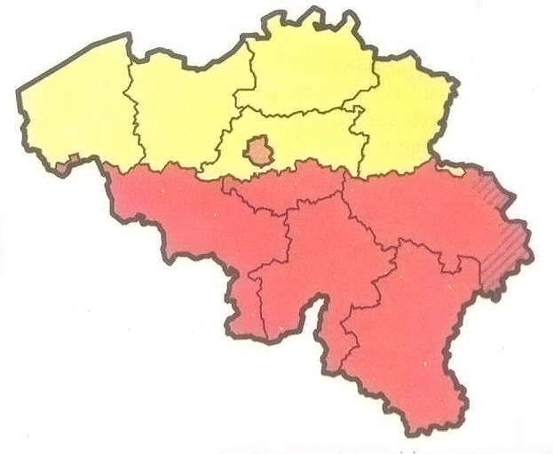
Communities & Regions of Belgium
Brussels – Capital Region – Dutch were a Minority
Flemish – 59% - Dutch – benefit of education and economic development.
German – 1%
Wallonia – 40% - French – Rich & Powerful

Slide 3
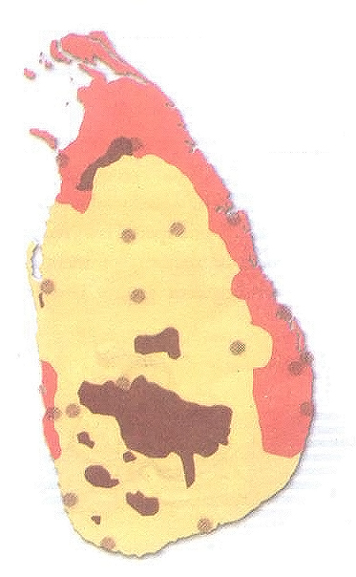
Ethnic Communities of Sri Lanka
Sri Lankan Tamils – Occupy N & E – Hindus & Muslims
Sinhalese – 74% - Buddhist –
Both Sinhalese & Tamil – 7% - Christian
Tamils – 18%
Muslims – 1%
Indian Tamils – Hindus & Muslims

Slide 4
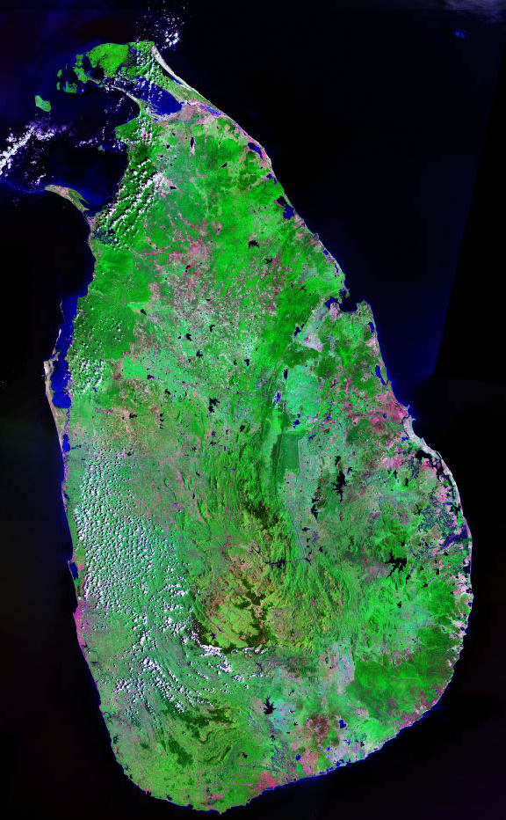
Reasons for Alienation of Sri Lankan Tamils / Majoritarianism in Sri Lanka

Slide 5

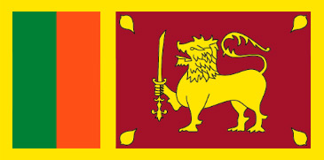
Reasons…
Dominance of Sinhalese community due to majority
1956 Act made Sinhala as the only official language
Preferential policies favouring Sinhalese in university position and jobs
State to protect and foster Buddhism

Slide 6
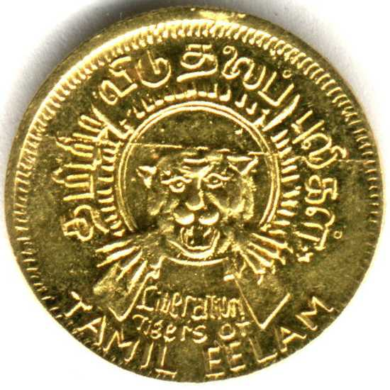
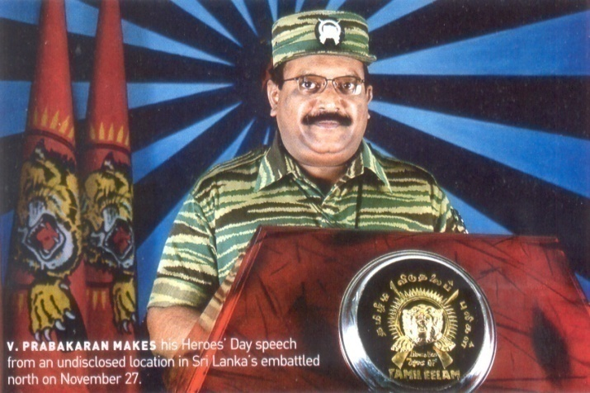
Position of Sri Lankan Tamils…
Launched political parties and struggles for recognizing Tamil as an official language
Demanded autonomy
Equal opportunity in education and jobs
Political organization was formed demanding an independent TAMIL EELAM
in North & East Sri Lanka

Slide 7

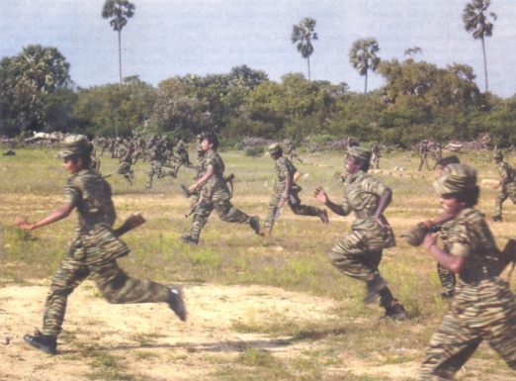
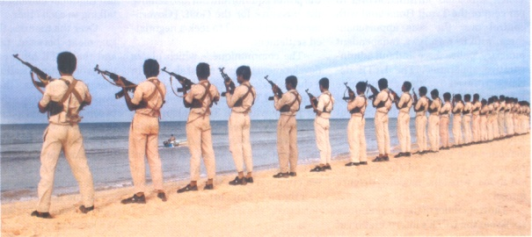
Civil War…
Causes
Both sides started
distrusting each other
Effects
Social,Cultural& Economic
setback

Slide 8
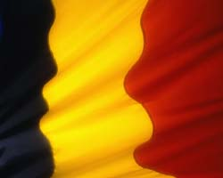
Power Sharing by
Accommodation in
Belgium

Slide 9

Power Sharing - Belgium
Equal number of Ministers from Dutch and French speaking areas in the Central Govt.
No single community can make decisions unilaterally
Transfer of power from the centre to the state. State govt. will not be a subordinate to the centre.
Separate govt. in Brussels with equal representation for the French and the Dutch.
Formation of COMMUNITY Govt elected by the people belonging to one language community Dutch, French and German wherever they live. This has power regarding
Culture, education and language related issues.

Slide 10
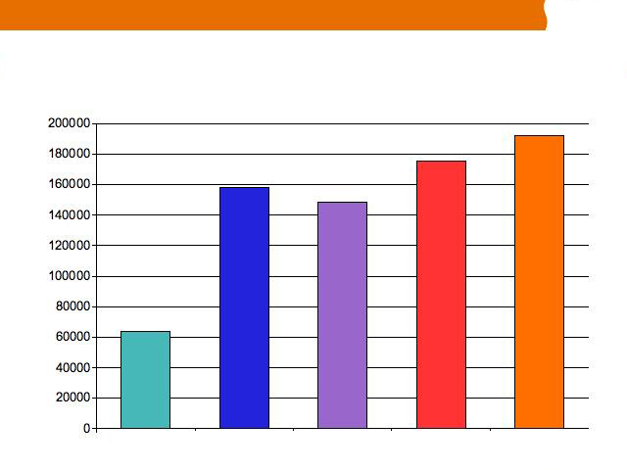
Power Sharing - Result
The country united respecting the feelings of different communities and regions.

Slide 11
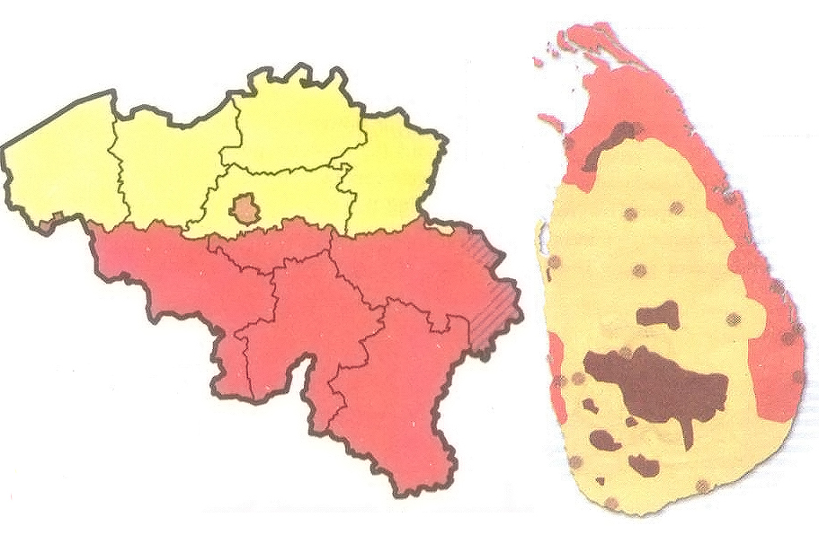
Belgium & Sri Lanka
Similarities: Both are democracies.
Differences: Power sharing arrangement is different.
What is unique about Belgium?
Leaders have realized that unity of the country is possible only by respecting the feelings and interests of different communities and regions.
What was the drawback in the system followed by Sri Lanka?
Dominance of majority community - Sinhalese by refusing to share power with Tamils resulting in disunity.

Slide 12

Why is Power Sharing desirable in a Democracy?
Prudential
Reduces conflicts between
social groups.
2. Stability of political order.
3. Better outcome.
Moral
1. It is the spirit of democracy.
2.People have the right to be consulted for governing practices.
3. Power sharing is valuable.

Slide 13

Why in a democracy should political power be distributed?
People are the source of all power.
People rule themselves through institutions of self governance.
Due respect is given to diverse groups and views.
All have a voice in shaping public policies.

Slide 14
Forms of Power sharing…
Amongst different organs of Govt. legislature, executive and judiciary
Results in balance of power
Horizontal distribution as it allows different organs to exercise different powers
All ministers /Govt. Officials are responsible to parliament/ state assemblies
No organ gets unlimited powers
Each organ checks the other
A system of checks and balances
Judges can also check the work of other organs

Slide 15
Forms of Power sharing…
Among Govts. at different levels
A general govt. for the entire country-called Centre and govts at the provincial/regional level. Federal Govt.
State Govt.
Constitutional distribution of power to the state and centre
Same with Panchayat and Municipality
Vertical division of power

Slide 16
Forms of Power sharing…
Different Social groups, religious/ linguistic
Accommodates social diversities who would feel otherwise alienated.

Slide 17
Forms of Power sharing…
Political parties, pressure groups and movements influence those in power
Influence of interest groups-businessmen, industrialists, farmers and industrial workers.
Formation of coalition Govt.when different parties form alliances

